Slide 1
COURSE
PROJECT
Automation of selection of
materials for repair
apartments

Slide 2


WHAT WE WORKED ON
"Automation of the selection of materials for apartment repairs" - is designed to summarize information about the availability of certain building materials that may be necessary for apartment repairs, depending on the wishes and needs of a particular client.

Slide 3



CLIENT REQUIREMENTS
Java
SQLite
Computer skills

Slide 4



PROGRAMM USAGE
Companies
Construction companies
People who build a private house

Slide 5
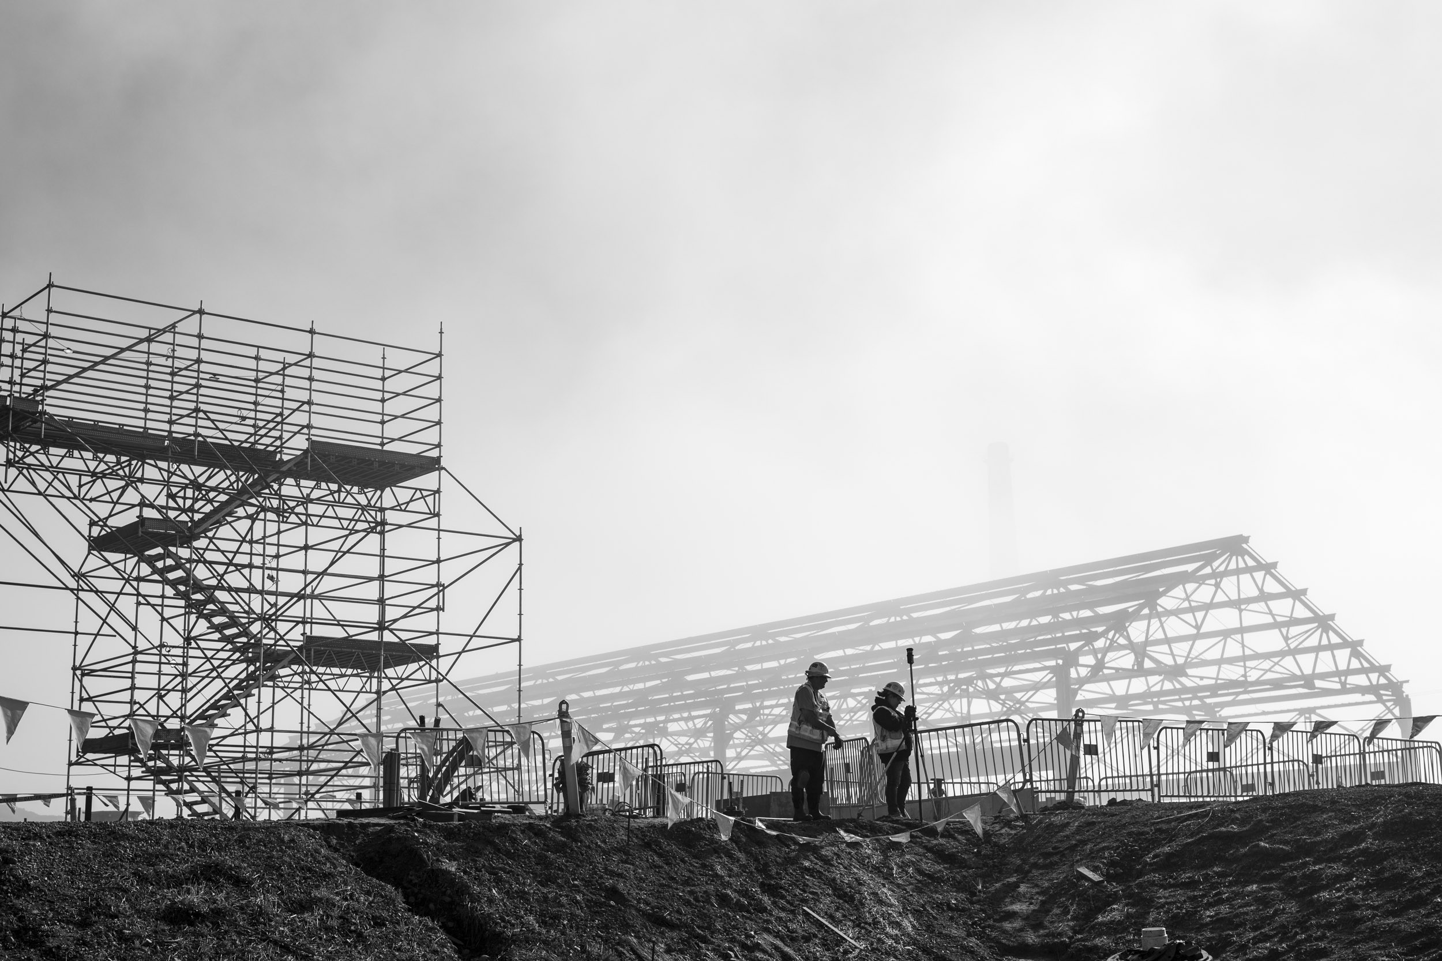
85%
Construction companies will switch to an automated system

Slide 6

103 construction companies in KYRGYZSTAN

Slide 7



PROGRAM’S USERS
FOREMAN
OWNERS
DELIVERY MAN
The foreman can view all existing owners from the database. He can also see the list of materials, the material with the certain price.
The owner can look at the list of building materials, search for a specific building material in the list. Can order building materials from the list.
The delivery man can view the list of delivered and ordered materials. And also provide personal data for delivery.

Slide 8
PROJECT CALENDAR
FEBRUARY
MARCH
APRIL
MAY
Familiarization with the terms of reference and drawing up a plan.
Writing the beginning of the code and documentation
Concluding the code and documentation. Testing the code from bugs
Presentation and the final stage of our course project

Slide 9
Teamwork
Analyzing problems
1
3
In every group work, the most important skill is the teamwork
The one who does nothing is not mistaken. Don't be afraid to make mistakes - be afraid to repeat mistakes..
Coding skills
Working with database
2
4
Coursework in programming languages ​​has significantly increased our coding skills
Working with databases helped us master this topic and expanded our capabilities

Slide 10
CONTACT INFO
ADDRESS
34b Maldybaeva St. ,Bishkek, Kyrgyzstan
EMAIL ADDRESS
PHONE NUMBER
ersu_ersu@mail.ru
sharshenkulov.1@gmail.com
kubatbekovalaken@gmail.com
kushtarbekovkuba@gmail.com
dastan.bak@gmail.com
+996 (500) 17-45-35
+996 (755) 06-95-51
+996 (705) 66-71-02
+996 (778) 39-36-07
+996 (773) 42-82-01

